Slide 1

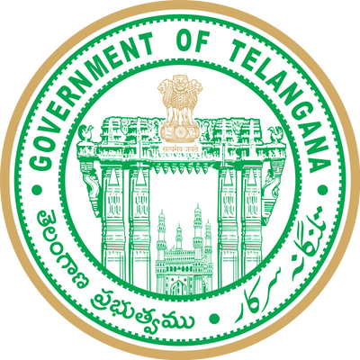


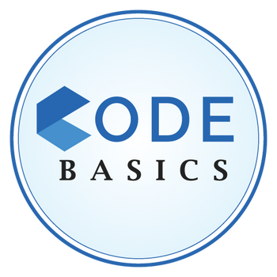
Telangana Growth Analysis
Presented by Rajesh

Slide 2
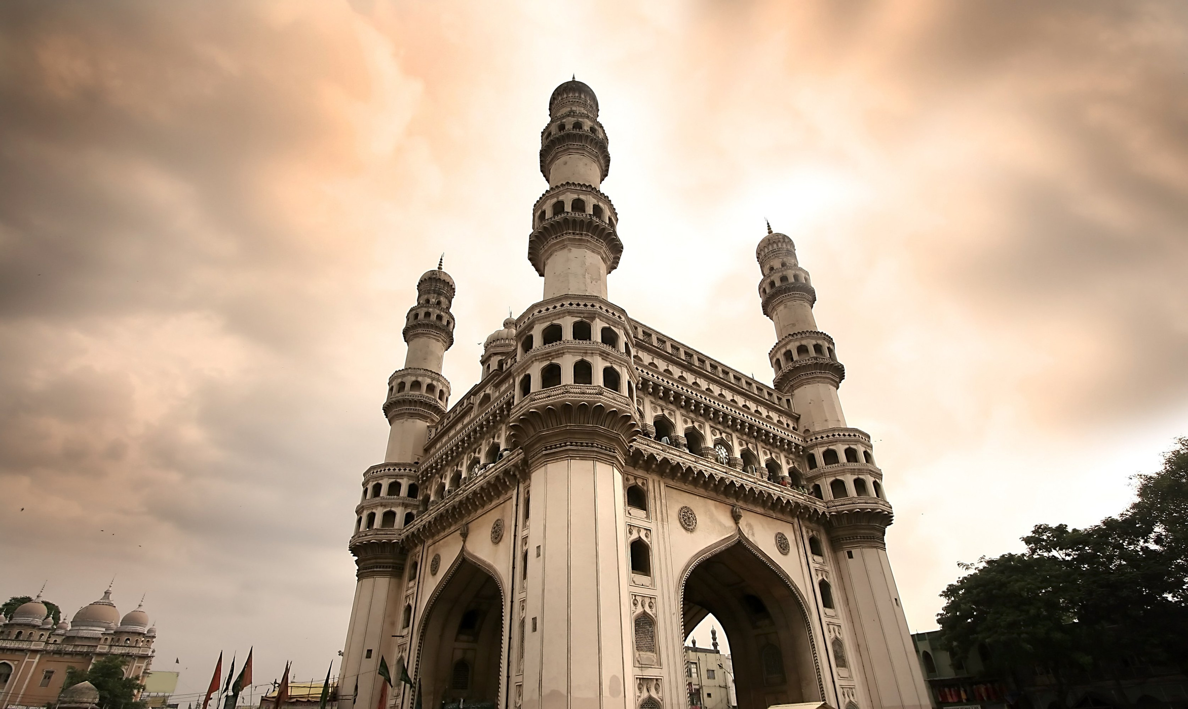


Introduction
Stamp Registration
Agenda
Primary Research
Transportation
Ts-I pass
Secondary Research
Insights and recommendations

Slide 3
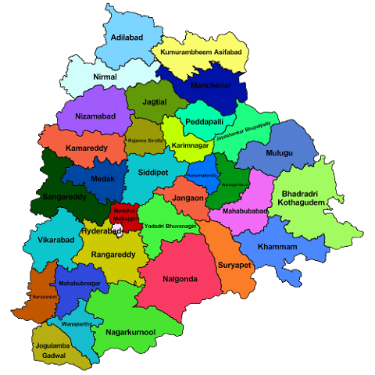
About Telangana
Telangana is India's youngest state, formed in 2014. capital city is Hyderabad, is a global IT hub with famous landmarks like the Charminar.
The state has seen fast economic growth, especially in IT, pharmaceuticals, and manufacturing.
Telugu and Urdu are the official languages.
Government is focused on digital services, development projects, education.

Slide 4



Slide 5


Stamp Registration

Slide 6
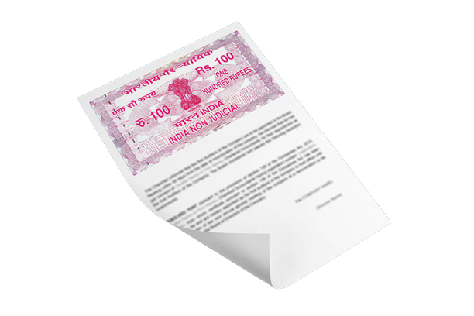
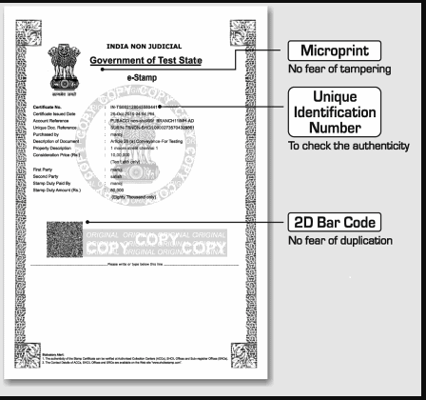
Stamp Registration
Document Registration
E-Stamp Registration

Slide 7
1:- How does the revenue generated from document registration vary across districts in Telangana? List down the top 5 districts that showed the highest document registration revenue growth between FY 2019 and 2022.
Hanuma konda
8bn
Sanga Reddy
22bn
This top 5 districts are document revenue 80% of the total.
Rangareddy leads the 37%, while Medchal Malkajgiri follows with 21%. Hyderabad, Sangareddy, and Hanumakonda collectively make up to 23%.
These districts have Urban infrastructure Development, educational institutions, IT and Commercial Spaces, and transportation connectivity.
Hyderabad
38bn
Rangan Reddy
108bn
Medchal Malkajgiri
64bn
Top 5 Districts by Document registration revenue

Slide 8
The top 5 districts that showed the highest document registration revenue growth between FY 2019 and 2022.
30%
28.3%
22.2%
Mulugu, Adilabad, Karimnagar, Mancherial, and Medchal Malkajgiri
The revenue from document registrations has grown between FY 2019 and 2022.
This growth can be attributed to several factors: the construction of roads, highways, and industrial zones in these areas, and an increase in property transactions, both for homes and businesses.
These factors have contributed significantly to the rise in revenue in these districts.
20%
17.8%
17.7%
17.7%
10%
0%
Mulugu
Adilabad
Karimnagar
Mancherial
Medchal malkajgiri

Slide 9
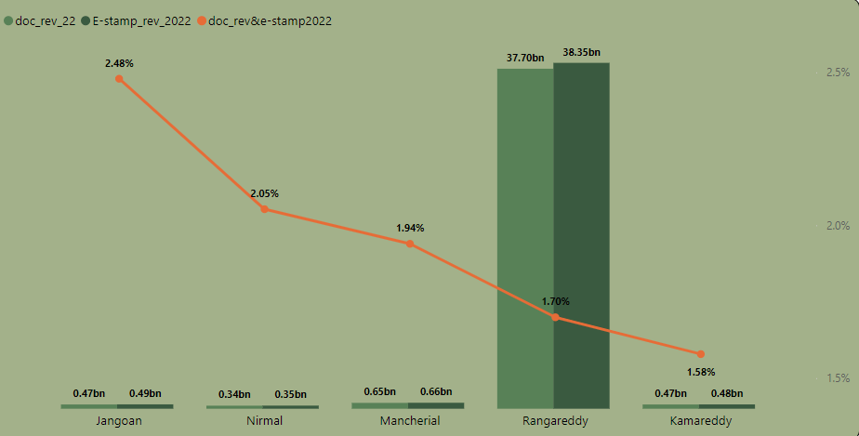
2:- How does the revenue generated from document registration compare to the revenue generated from e-stamp challans across districts? List down the top 5 districts where e-stamps revenue contributes significantly more to the revenue than the documents in FY 2022?
Janogaon, Nirmal, Mancherial, Rangareddy and Kamareddy, as increasing importance of electronic stamping as a preferred method of revenue collection in these districts, highlighting the growing digitalization of administrative processes.

Slide 10
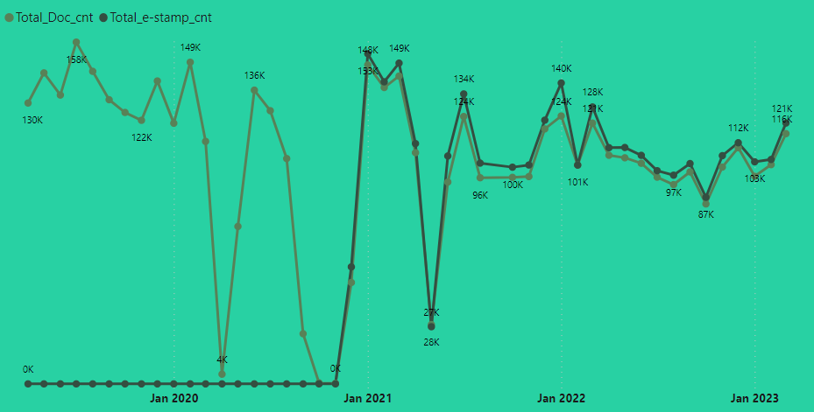

3:- Is there any alteration of e-Stamp challan count and document registration count pattern since the implementation of e-Stamp challan? If so, what suggestions would you propose to the government ?
Since the implementation of e-Stamp challan, we observed some changes in the pattern of document registration counts.
In April 2020, there was a drop in document counts due to the COVID-19 pandemic.
Additionally, the Telangana government introduced a new revenue act in 2020, leading to a temporary halt in document registrations from September 2020 to November 2020.
It's important to note that data for e-stamp registration is available from December 2020 onwards.
During this period, the government launched the DARANI WEBSITE PORTAL for online property registration.
There was another drop in May 2021 due to the COVID-19 lockdown. Overall, we can see that both document and e-stamp counts became relatively similar in each month.

Slide 11
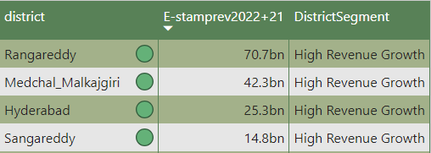
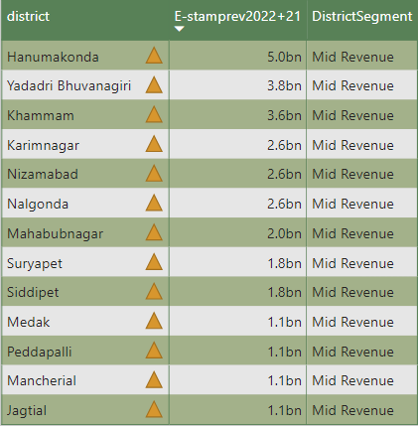
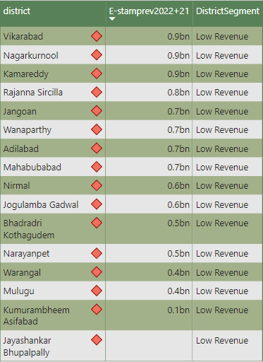
4. Categorize districts into three segments based on their stamp
registration revenue generation during the fiscal year 2021 to 2022.
High Revenue
Mid Revenue
Low Revenue

Slide 12
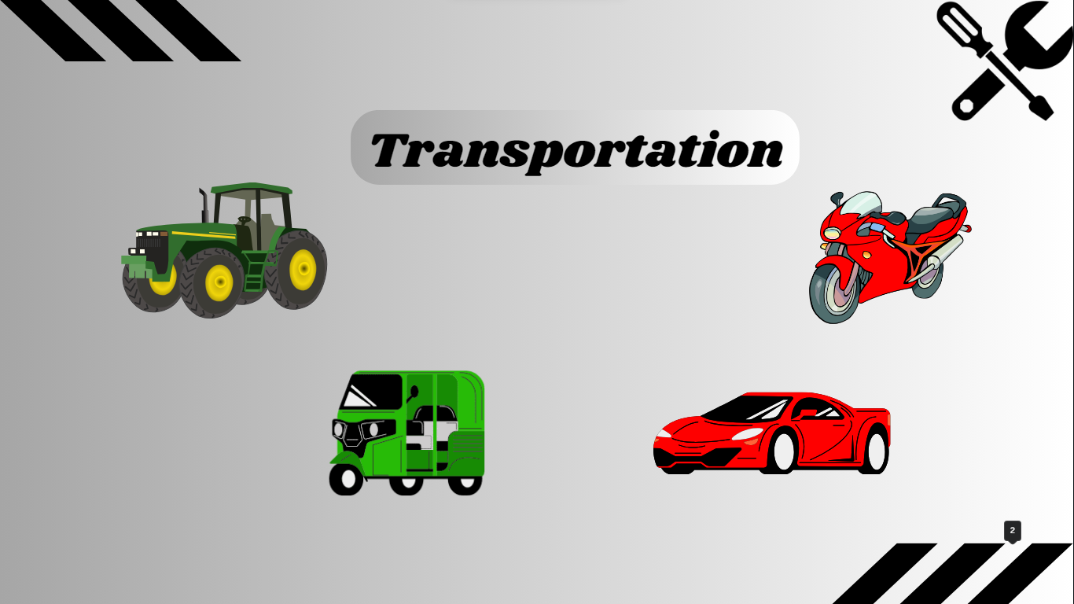

Slide 13
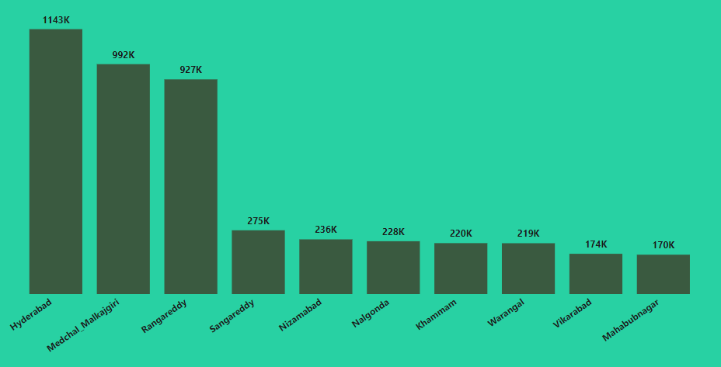
5. Investigate whether there is any correlation between vehicle sales and specific months or seasons in different districts. Are there any months or seasons that consistently show higher or lower sales rate, and if yes, what could be the driving factors? (Consider Fuel-Type category only)
Top 10 Districts vehicle sales (Fuel –Type Category)
Vehicle sales are highest in Hyderabad, followed closely by Medchal Malkajgiri and Rangareddy, mainly due to their urban population and economic activities.
Urban areas tend to have higher sales due to better job opportunities and infrastructure.
Sangareddy and Nizamabad, Warangal, Vikarabad, and Mahabubnagar represent growth opportunities for the automotive sector.

Slide 14
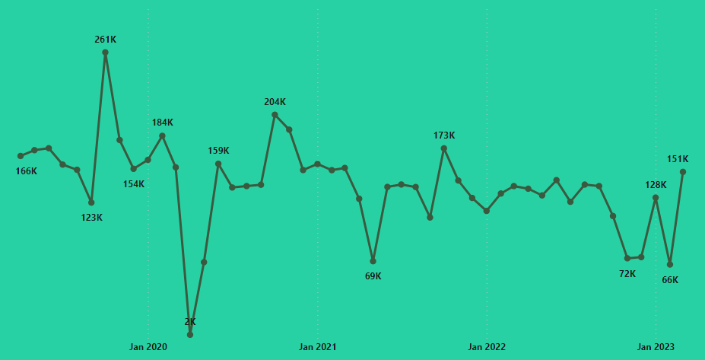
Monthly wise vehicle sales (Fuel –Type Category)
Peak in October: Celebrations during Dasara and Devi Nava Rathiri boost sales, with people taking advantage of special discounts.
Lowest in April 2020 and May 2021: The COVID-19 pandemic led to a sharp decline in sales.
Steady trend: However, sales remained consistent from December 2021 to September 2022, indicating stability in the market.
Challenges Sales Drop in November and December 2022 due to rising inflation and Decreased ownership costs.

Slide 15
6. How does the distribution of vehicles vary by vehicle class (MotorCycle, MotorCar, AutoRickshaw, Agriculture) across different districts? Are there any districts with a predominant preference for a specific vehicle class? Consider FY 2022 for analysis.
Top 5 Districts MotorCycle Vehicles
Hyderabad
207K
Motorcycle sales were highest in Hyderabad, followed by Medchal Malkajgiri and Rangareddy, indicating a preference for motorcycles.
Sangareddy and Nizamabad also in motorcycles sales.
This suggests that motorcycles are a popular choice for daily commuting in these districts, offering flexibility for employees traveling within a 20km range to their workplaces.
Medchal malkajgiri
165K
Rangareddy
154K
Sangareddy
41K
Nizamabad
28K
50 K
100 K
150 K
200 K
250 K

Slide 16
Top 5 Districts Motorcar Vehicles
Rangareddy
72K
In FY 2022, Rangareddy leads in car sales, closely followed by Medchal Malkajgiri, and Hyderabad also shows strong demand for cars.
Sangareddy and Khammam indicate a preference for cars due to good infrastructure and the emergence of major IT hubs, prompting individuals to opt for their own vehicles for daily commuting.
Medchal malkajgiri
61K
Hyderabad
51K
Sangareddy
15K
Khammam
6K
0K
25K
50K
75K

Slide 17
Top 5 Districts Auto Rickshaws Vehicles
Hyderabad
8397
Auto rickshaws play a crucial role in transportation in Hyderabad, Sangareddy, Khammam, Vikarabad, and Bhadradri Kothagudem.
Serving as vital options for last-mile travel and creating job opportunities across urban and rural areas.
Sangareddy
3381
Khammam
2690
Vikarabad
2046
Bhadradri Kothagudem
1388
0
2,500
5,000
7,500
10,000

Slide 18
Top 5 Districts Agriculture Vehicles
Nalgonda
2599
Nalgonda, Siddipet, Suryapet, Khammam, and Bhadradri Kothagudem are the top districts in FY 2022 for agriculture vehicle preference. These districts likely have a significant agricultural sector, where these vehicles are essential for farming activities. This indicates the importance of agriculture in these regions for livelihoods and the economy.
Siddipet
2437
Suryapet
2188
Khammam
2121
Bhadradri Kothagudem
2013
0
1,000
2,000
3,000

Slide 19
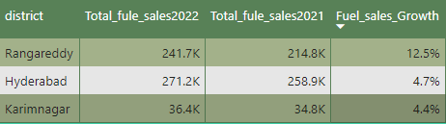
7. List down the top 3 and bottom 3 districts that have shown the highest and lowest vehicle sales growth during FY 2022 compared to FY 2021? (Consider and compare categories: Petrol, Diesel and Electric)
Top 3 Districts Fuel vehicle Sales Growth
Top 3 districts with fuel sales growth in 2022 compared to 2021 are Rangareddy leads with an impressive 12.5% growth rate, followed closely by Hyderabad at 4.7%, and Karimnagar at 4.4%. These growth figures highlight the robust economic activity and urbanization trends in these districts.

Slide 20
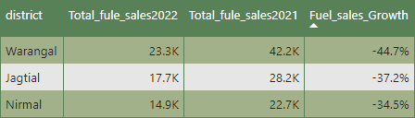
7. List down the top 3 and bottom 3 districts that have shown the highest and lowest vehicle sales growth during FY 2022 compared to FY 2021? (Consider and compare categories: Petrol, Diesel and Electric)
Bottom 3 Districts Fuel vehicle Sales Growth
Bottom 3 Districts in vehicle sales in 2022 compared to 2021 Warangal, Jagtial, and Nirmal districts faced substantial drops in vehicle sales at -44.7%, -37.1%, and -34.4% respectively
These declines highlight the need to tailor business approaches to fit local market. changing consumer preferences

Slide 21

TS- IPASS (Telangana State Industrial Project Approval and Self-Certification System)

Slide 22
8. List down the top 5 sectors that have witnessed the most significant
investments in FY 2022.
Plastic & Rubber
5855 Cr
Plastic and Rubber: Thriving due to high demand.
Pharmaceuticals and Chemicals: Steady growth, supporting various industries.
Real Estate and Industrial Parks: Investment in infrastructure continues, driven by urbanization.
Solar and Renewable Energy: Commitment to sustainable power generation.
Engineering: Growing demand for engineering services, reflecting economic development.
Pharmaceutical and chemicals
2181 Cr
Real-estate, Industrial Parks and it buildings
2127 Cr
Solar and other renewable energy
2052 Cr
Engineering
1877 Cr
0
2,000
4,000
6,000

Slide 23
9. List down the top 3 districts that have attracted the most significant sector investments during FY 2019 to 2022? What factors could have led to the substantial investments in these particular districts?
Medchal malkajgiri
10K
In Rangareddy has most investment in come from real estate, industrial parks and IT buildings
In Sanagreddy plastic and rubber, automobile.
Medchal_malkajgiri investment in pharmaceutical, and chemical engineering Sectors.
These districts have strategic location, robust infrastructure, government support.
Sangareddy
12K
Rangareddy
43K
Top 3 Districts most significant investments

Slide 24
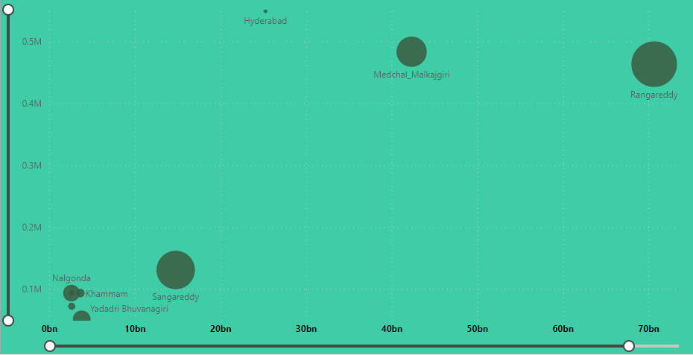
10. Is there any relationship between district investments, vehicles sales and stamps revenue within the same district between FY 2021 and 2022?
District Investments, Vehicle Sales, and E-Stamp Revenue: Analysis reveals that relationships among these factors in between FY 2021 and 2022.
A positive correlation exists, indicating that districts with higher vehicle sales tend to have more revenue from e-stamp collections and investments
Top-Performing Districts: Rangareddy, Medchal Malkajgiri, and Sangareddy emerge as leading districts in terms of revenue, Hyderabad has less in investments

Slide 25
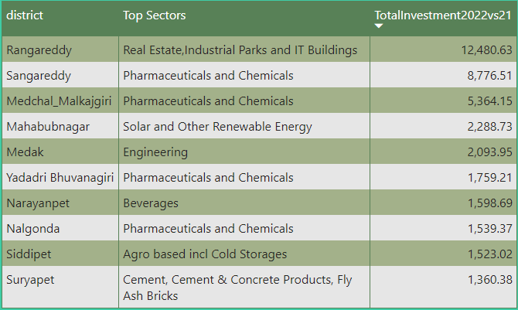
11. Are there any particular sectors that have shown substantial investment in multiple districts between FY 2021 and 2022?
Rangareddy top investment in Real Estate & Parks
Sangareddy, Medchal, Yadadri Bhuvanagiri, Nalgonda as investment in Pharmaceutical & Chemicals
in Medak have invest in Engineering
Narayanpet, Siddipet have Beverages, Agro & Cold Storages

Slide 26
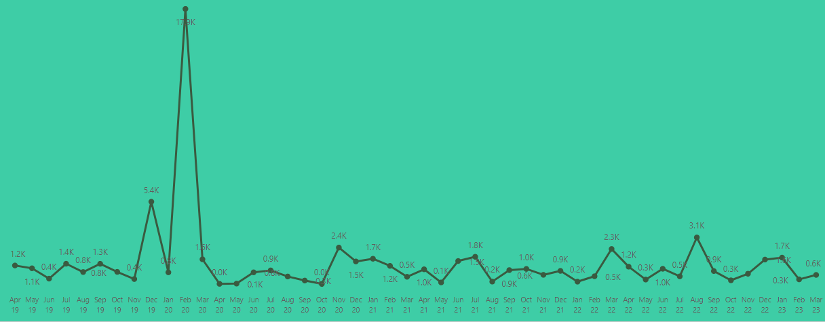
12. Can we identify any seasonal patterns or cyclicality in the investment trends for specific sectors? Do certain sectors experience higher investments during particular months?
In February 2020 had higher investments compared to other months, with the majority of investments coming from the real estate, industrial parks, and IT buildings sector. The rest of the months had more stable investment patterns.
In August 2022, there was a significant in investments in the rubber and plastic sector, as well as in real estate, IT buildings, and industrial parks. In general, it appears that real estate, industrial parks, and IT buildings sector consistently attract investments.
Investment Cr. Trend during particular months

Slide 27
Secondary Research

Slide 28
1. What are the top 5 districts to buy commercial properties in
Telangana? Justify your answer.
01.
02.
03.
Hyderabad: Hyderabad is not only the capital but also the largest city in Telangana. It boasts a thriving IT sector, pharmaceutical industry, and various other businesses. This diverse economic landscape makes it an attractive destination for commercial property investments.
Rangareddy: This district has seen growth in commercial real estate. Its proximity to the city and the presence of IT parks, industrial zones, and SEZs make it a favorable choice for businesses looking to capitalize on Hyderabad's economic opportunities.
Medchal Malkajgiri: This district's rapid urbanization and infrastructure development have made it a hotspot for commercial property investments. Its strategic location, situated to the north of Hyderabad,

Slide 29
04.
05.
Sangareddy: Sangareddy district is emerging as a key player in the Rubber and plastic market. Its location along the National Highway and the proposed Regional Ring Road has attracted industries and logistics businesses. Government initiatives to boost infrastructure and connectivity further enhance its potential.
Warangal Urban: The district's industrial parks and improved road networks have encouraged businesses to invest in commercial properties. Its central location in the state also adds to its attractiveness.

Slide 30
2. What significant policies or initiatives were put into effect to enhance economic growth, investments, and employment in Telangana by the current government? Can we quantify the impact of these policies using available data?
TS-iPASS.
Dharani
Mission Bhagiratha
Dharani Integrated Land Records is the official portal for registration of agricultural and non-agricultural public property in the state of Telangana. Dharani was started by the Telangana government (land administration department) for the first time in the country
Bhagiratha is a significant water project in Telangana, aimed at providing clean piped water to millions of people in both urban and rural areas. The project sources water from Rivers Godavari and Krishna and is scheduled for completion by December 2018,
This process for obtaining approvals and permissions has led to a significant increase in approved projects, investments, and job creation.
T-Hub and T-Works.
Infrastructure Development
Initiative innovation and entrepreneurship, contributing to economic growth and job opportunities in the technology sector.
Heavy investments in infrastructure development have enhanced the state's attractiveness for businesses and residents.

Slide 31
3. Provide top 5 Insights to Telangana government for sustained growth in the next 5 years based on your analysis
01.
02.
03.
Strategic Investment in Infrastructure: The concentration of investments in districts like Rangareddy, Sangareddy, and Medchal Malkajgiri suggests that these areas have strategically invested in infrastructure, making them more appealing to businesses. For instance, Rangareddy has attracted over 43K crore rupees in investments, largely due to such strategic infrastructure developments.
Sector Diversity: investments are spread across a wide range of sectors. These include plastic and rubber, automobile, pharmaceuticals, and chemicals. This diversity in investment sectors is a good sign for the state's economy, making it more stable and adaptable.
The rise in document registration revenue in districts like Mulugu, Adilabad, Karimnagar, Mancherial, and Medchal Malkajgiri. For example, Mulugu's revenue from document registration grew by 28.3%, indicating a lot of economic activity."

Slide 32
3. Provide top 5 Insights to Telangana government for sustained growth in the next 5 years based on your analysis
04.
05.
In car sales in different areas tells us that people are buying cars differently in each place. This can help businesses sell the right cars in each area. For example, in Warangal, car sales went down a lot by -44.7%, and in Nirmal, they went down by -34.4%
Seasonal investment that certain sectors, like fertilizers and real estate, witness heigh activity. For instance, December 2019 saw significant investments, especially in the fertilizer, real estates sector, while February 2020 and August 2022 also record investments

Slide 33
3. Provide 5 recommendations to Telangana government for sustained growth in the next 5 years based on your analysis
Diverse Economy
Balanced Development
Data-Driven Decisions
Encourage the development of emerging sectors to reduce dependence on specific industries.
Allocate funds and initiate projects in smaller towns and rural areas to faster economic growth and development across the entire state.
Utilize data wisely to make informed decisions This way, the government can make better rules and changes in business.
Sustainability Focus
Skill Building
Be Earth-Friendly Support businesses that don't hurt the environment. Make sure growth is good for nature and society for a cleaner and better future.
Teach Skills: Make sure people have the right training for new jobs. Invest in schools and training centers to help everyone get ready for better work.

Slide 34



Thank you
very much!
Dhaval Patel
Founder of Codebasics
Hemanand Vadivel
Co-Founder - Codebasics

